Slide 1
LOGISTIC REGRESSION

Slide 2
LOGISTIC REGRESSION:
Logistic Regression is a supervised Machine Learning algorithm.
It falls under Classification technique.
Logistic Regression predicts the output of a categorical dependent variable. Therefore, output must be categorical or discrete value.

Slide 3
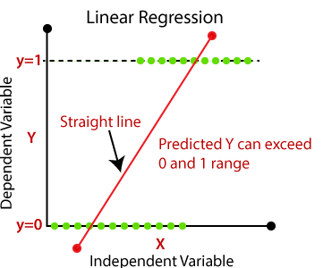
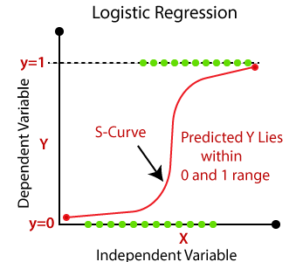
Logistic Regression is basically extension of Linear Regression where target variable is categorical nature.
In Logistic Regression instead of fitting a regression line (or best fit line) we fit ‘ S ’ shaped curve, which predicts the two maximum values (0 or 1).
Here we use logit or Sigmoid function.

Slide 4
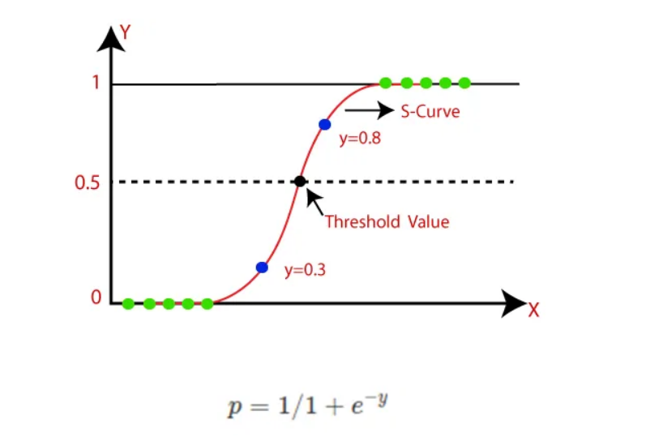
SIGMOID FUNCTION ( LOGISTIC / LOGIT FUNCTION)
It is a mathematical function used to map the predicated values to probabilities.
It maps any real value into another value within a range of 0 and 1.
In Logistic Regression, we use Threshold value.
Threshold value will defines the probability of either 0 or 1.

Slide 5
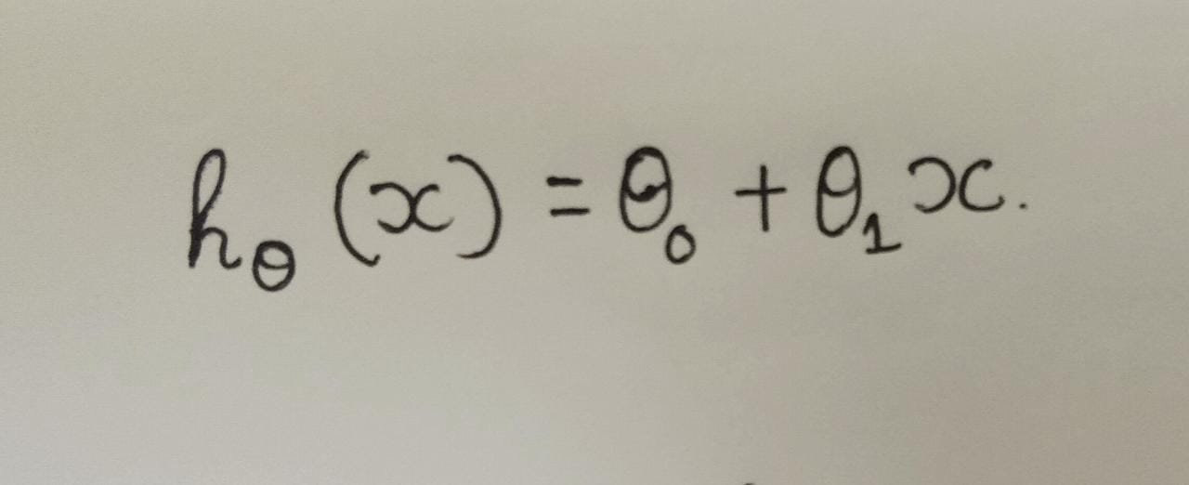
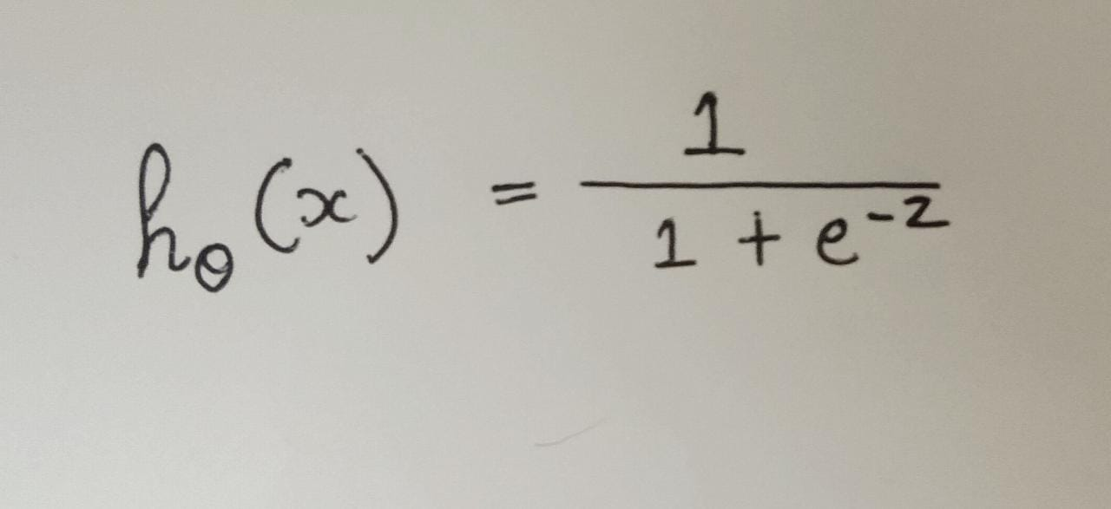

FORMULA
$h_{\text{θ}}$(x)θ=$\frac{1}{1+e^{−({\text{θ}}_{0}\text{+} {\text{θ}}_{1}\text{x} )}}$
$h_{\text{θ}}$(x)= dependent variable
${\text{θ}}_{0}=$ intercept (constant)
${\text{θ}}_{1}$= slope(co-efficient of x)
X= independent variable
Linear Regression
Sigmoid Function

Slide 6
Why is it named as Logistic Regression?
It is named as so ‘Logistic Regression’ because its underlying technique is quite same as linear regression.
The term ‘Logistic’ is taken from the logit function that is used in this method of classification

Slide 7
Types of Logistic Regression
Binomial
Multinomial
Ordinal

Slide 8
Assumption of Logistic Regression
There is minimal or no multicollinearity among the independent variables.
Assumes that the observations to be independent of each other.
The dependent variable must be categorical in nature.

Slide 9
Advantages
Easy to implement, interpret and very efficient to train.
Good accuracy for many simple datasets.
It is very fast at classifying unknown records.
Logistic regression is less inclined to overfitting but it can overfit in high dimensional datasets.

Slide 10
Disadvantages
Overfits on high dimensional data.
Only important and relevant features should be used otherwise model’s predictive value will be degraded.
It is tough to obtain complex relationships using Logistic Regression.

Slide 11
Applications
Used to calculate or predict the probability of binary event occurring.
Credit Scoring.
To predict the cancers.

Slide 12


